Slide 1







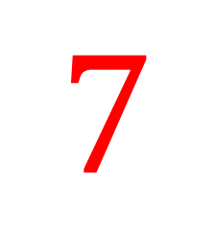

My Number Interactive Workbook
$$×$$
$$\frac{1}{2}$$
$$÷$$
$$+$$
$$−$$
$$\frac{3}{5}$$
$$7$$
Name
Class
Teacher
Term 1 Semester 1
$$5^{2}$$
$$\sqrt{9}$$
1

Slide 2
Create your own front page
It needs to contain the following –
My number interactive notebook
Name
Class
Teachers Name
Semester 1 Term 1
Page number 1

Slide 3
Contents
Glossary or Formula Page
Page
Date
Description
2
3

Slide 4
Tasks
24
7
30
Essential Question
Questions
Notes
Summary
4
5

Slide 5
24
7
30
Date
Index Notation
EQ – How do I calculate the value of an integer to the power of a positive integer?

Slide 6
24
7
30
Date
Index Notation
EQ – How do I calculate the value of an integer to the power of a positive integer?
What is index law 1?
$a^{m}$ x $a^{n}$ = $a^{m+n}$

Slide 7
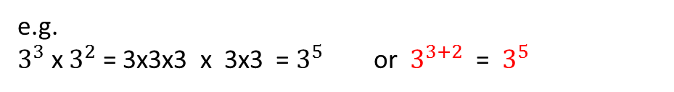
24
7
30
Date
Index Notation
EQ – How do I calculate the value of an integer to the power of a positive integer?
What is index law 1?
$a^{m}$ x $a^{n}$ = $a^{m+n}$
e.g.
$3^{3}$ x $3^{2}$ = 3x3x3 x 3x3 = $3^{5}$ or $3^{3+2}$ = $3^{5}$

Slide 8

24
7
30
Date
Index Notation
EQ – How do I calculate the value of an integer to the power of a positive integer?
What is index law 1?
$a^{m}$ x $a^{n}$ = $a^{m+n}$
e.g.
$3^{3}$ x $3^{2}$ = 3x3x3 x 3x3 = $3^{5}$ or $3^{3+2}$ = $3^{5}$
What is index law 2?
$a^{m}$ ÷ $a^{n }$ = ${a }^{m−n}$

Slide 9
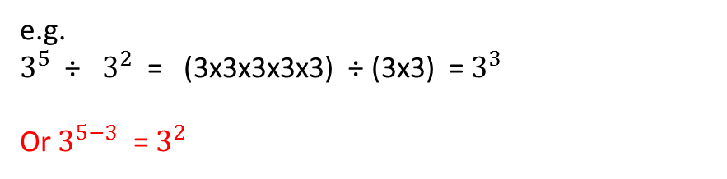
24
7
30
Date
Index Notation
EQ – How do I calculate the value of an integer to the power of a positive integer?
What is index law 1?
$a^{m}$ x $a^{n}$ = $a^{m+n}$
e.g.
$3^{3}$ x $3^{2}$ = 3x3x3 x 3x3 = $3^{5}$ or $3^{3+2}$ = $3^{5}$
What is index law 2?
$a^{m}$ ÷ $a^{n }$ = ${a }^{m−n}$
e.g.
$3^{5}$ ÷ $3^{2}$ = (3x3x3x3x3) ÷ (3x3) = $3^{3}$
Or $3^{5−3}$ = $3^{2}$

Slide 10
Task
Complete page 308 from your text books.
Extension:
Try question 16 on page 310.

Slide 11
Notes Review
24, 7 ,30
Date
Title
Essential question
Notes complete
Notes complete with colour and diagrams
Questions completed
Contents page filed in
Formula page filled in

Slide 12
Homework
Review your notes and write a summary answering the essential question.

